Slide 1
CREDIT CARD FRAUD DETECTION
BY
Keerthana S
220701124
Rajalakshmi Engineering College
220701124@rajalakshmi.edu.in
GUIDE
Dr. Auxilia Osvin Nancy,
Assistant Professor
Dept.Computer Science Engineering
Rajalakshmi Engineering College

Slide 2
Introduction
Credit card fraud is a major global issue causing significant financial losses.
Rise in digital transactions increases the need for intelligent fraud detection systems.
Traditional methods struggle with complex fraud and class imbalance.
Machine learning offers a scalable and adaptive solution.
This project evaluates multiple models to enhance precision, recall, and robustness.

Slide 3
Literature Survey – Background & Challenges
Traditional Approaches
Logistic Regression, Decision Trees, and SVM were commonly used.
Limited by poor performance on rare fraud cases.
Key Challenge: Class Imbalance
Legitimate transactions far outnumber fraudulent ones.
Leads to biased predictions and poor fraud detection.
Shift in Evaluation Metrics
Accuracy is misleading in imbalanced datasets.
Modern studies emphasize Precision, Recall, F1-score, AUC-ROC.

Slide 4
Literature Survey – Solution & Gaps
Importance of Data Preprocessing
Feature selection, normalization, and outlier handling boost performance.
Data Augmentation Techniques
SMOTE and Gaussian noise generation improve minority class learning.
Increase generalization capability of models.
Research Gaps
Real-time deployment still limited.
Need for adaptive models to evolving fraud patterns.

Slide 5
Objectives
Develop a predictive model to accurately detect fraudulent credit card transactions.
Handle data imbalance effectively to improve the detection of rare fraud cases.
Evaluate and compare supervised classifiers (e.g., XGBoost, Random Forest, SVM) for performance.
Enhance precision and recall to reduce false positives and false negatives.
Focus on data preprocessing and feature selection to boost model robustness and real-world adaptability

Slide 6
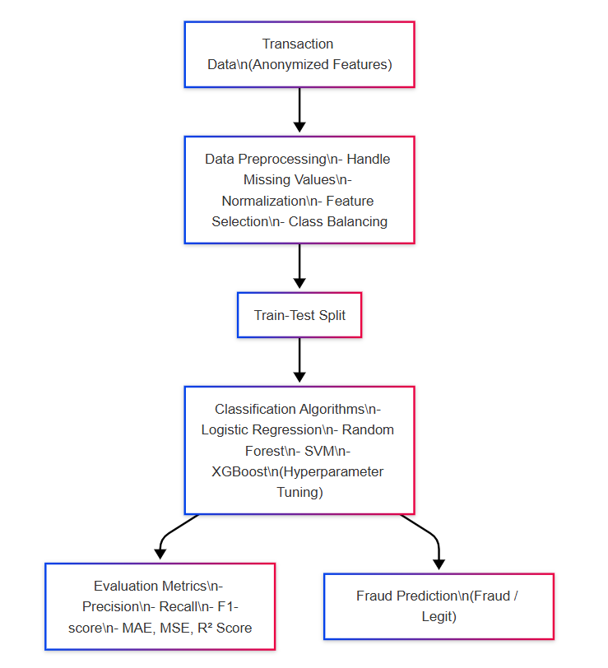
System Architecture

Slide 7
Methodology
Data Preprocessing
Cleaned and prepared transaction data
Handled missing values and encoded categorical features
Handling Imbalanced Data
Applied SMOTE to oversample the minority (fraud) class
Added Gaussian noise to increase data variability and realism
Model Training & Selection
Trained multiple models (Logistic Regression, SVM, Random Forest, XGBoost)
Tuned hyperparameters and evaluated performance using precision, recall,
F1-score, AUC
Model Interpretation & Deployment
Used LIME for explainability
Selected best-performing model for predicting fraud in new transactions

Slide 8
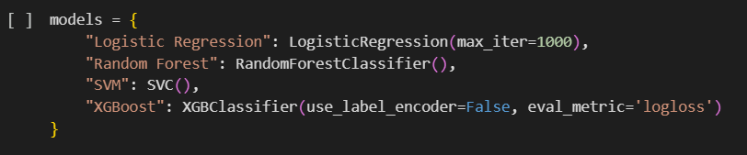
Implementation

Slide 9
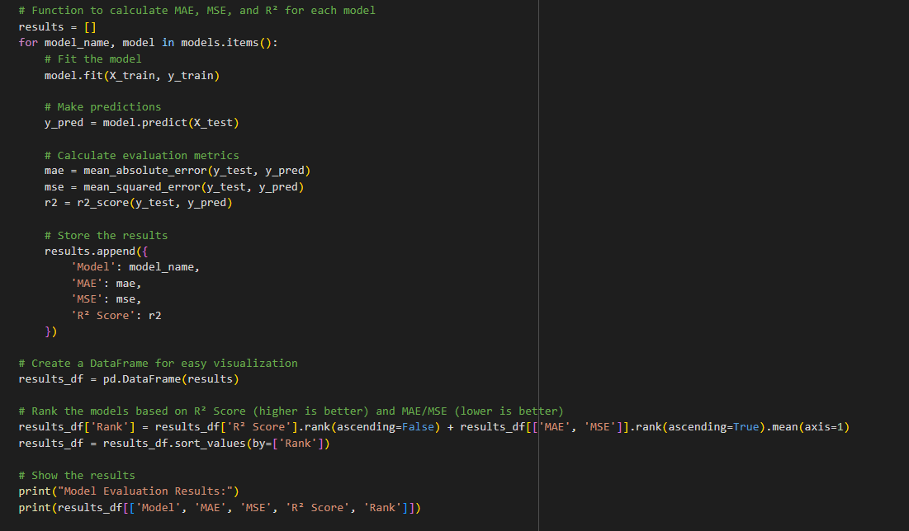
Implementation

Slide 10
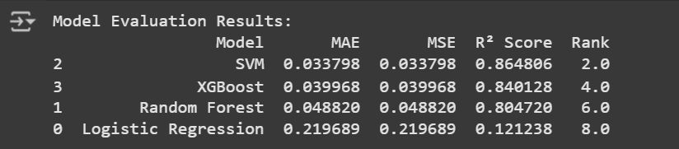
Implementation & Result

Slide 11
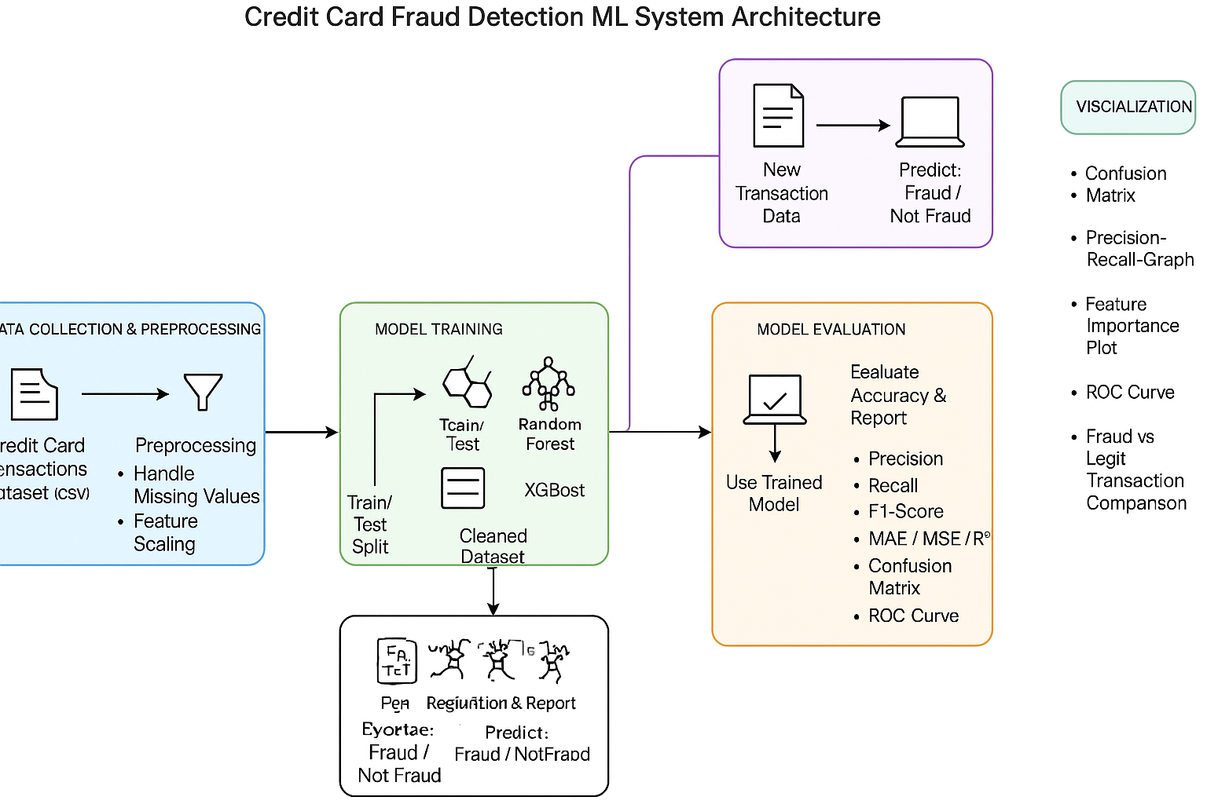
System Architecture

Slide 12
Comparison with existing work
Criteria | Existing Models | Current Model
Model Type | Logistic Regression, Decision Tree | Random Forest, XGBoost, SVM
Handling Class Imbalance | Basic techniques | SMOTE + Gaussian Noise for better minority class learning
Evaluation Metrics | Accuracy-centric | Precision, Recall, F1-Score, AUC-ROC
Preprocessing | Basic preprocessing | Feature selection + Noise injection for real-world variation
Interpretability | Moderate | LIME used for feature-level interpretability
Comparison with existing work

Slide 13
Conclusion and Future Work
Comparison with existing work
Conclusion: This project successfully demonstrated the effectiveness of machine learning models, particularly SVM and XGBoost , in detecting credit card fraud with high precision and recall. Robust preprocessing and augmentation significantly improved model performance despite class imbalance.
Future Work: Future efforts can focus on deploying these models in real-time systems such as mobile banking apps, integrating continuous learning from new data, and enhancing fraud detection using deep learning techniques.

Slide 14
Reference
Credit Card Fraud Detection Using Machine Learning Algorithms https://ieeexplore.ieee.org/document/9056952
Machine Learning for Credit Card Fraud Detection - A Comparative Study https://www.sciencedirect.com/science/article/pii/S1877050919310285
Credit Card Fraud Detection Using Random Forest Algorithm https://www.ijert.org/credit-card-fraud-detection-using-random-forest-algorithm
A Machine Learning Approach for Credit Card Fraud Detection Using XGBoost https://www.researchgate.net/publication/353626539_A_Machine_Learning_Approach_for_Credit_Card_Fraud_Detection_Using_XGBoost
Efficient Credit Card Fraud Detection using Supervised Machine Learning Algorithms https://www.sciencedirect.com/science/article/pii/S1877050921002280

Slide 15
THANK YOU

